Slide 1
Design and Analysis of Algorithms Brute Force Strategy
Week 7
By
Dr Rafiullah Khan
Senior Lecturer ICS/IT
The University of Agriculture Peshawar, Pakistan
For resources, please visit: https://rafiyz.github.io/courses/Algorithms/algo.htm

Slide 2
A man put a pair of rabbits in a place surrounded by a wall.
How many pairs of rabbits will be there in a year if the initial pair of rabbits (male and female) are newborn
and all rabbit pairs are not fertile during their first month of life but thereafter give birth to one new male/female pair at the end of every month?

Slide 3
Computing the nth Fibonacci Number
F(n) = F(n − 1) + F(n − 2) for n > 1
F(0) = 0, F(1) = 1.

Slide 4

Brute force is a straightforward approach to solving a problem, usually directly based on the problem statement and definitions of the concepts involved.
Just do it approach
Easy to apply
Exponentiation problem: compute a^{n} for nonzero number a and nonnegative integer n.
By the definition of exponentiation

Slide 5
Not a source of clever and efficient algorithm
But….. the brute-force approach should not be overlooked as an important algorithm design strategy
applicable to a very wide variety of problems

Slide 6
Sorting
Selection sort by scanning the entire given list to find its smallest element and exchange it with the first element, putting the smallest element in its final position in the sorted list and then scan the list, starting with the second element, to find the smallest among the last n − 1 elements and exchange it with the second element, putting the second smallest element in its final position, and so on

Slide 7
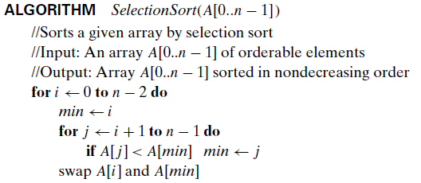


Slide 8
Bubble Sort
compare adjacent elements of the list and exchange them if they are out of order
By doing it repeatedly, we end up “bubbling up” the largest element to the last position on the list
The next pass bubbles up the second largest element, and so on, until after n − 1 passes the list is sorted.

Slide 9
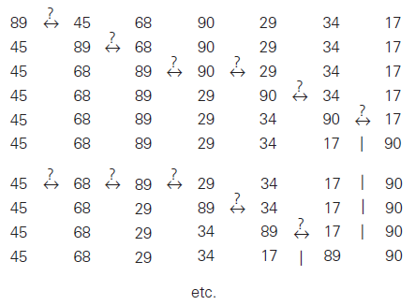

Slide 10
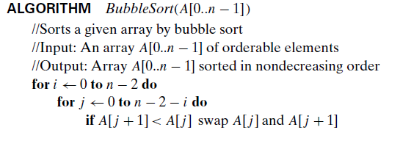
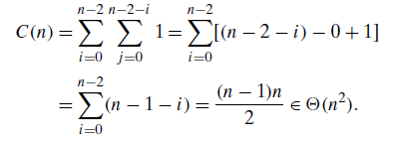

Slide 11
Assignment
Exercise 3.1 – Solve at least 8 problems out of 14. If someone will solve all the problems, then he will get bonus marks

Slide 12
Sequential Search
simply compares successive elements of a given list with a given search key until either a match is encountered (successful search) or the list is exhausted without finding a match (unsuccessful search).

Slide 13
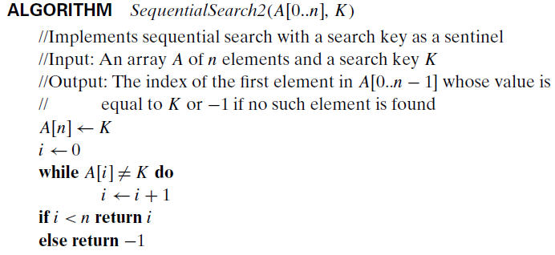

Slide 14
Brute-Force String Matching
given a string of n characters called the text and a string of m characters (m ≤ n) called the pattern, find a substring of the text that matches the pattern.
To put it more precisely, we want to find i—the index of the leftmost character of the first matching substring in the text—such that

Slide 15

If matches other than the first one need to be found, a string-matching algorithm can simply continue working until the entire text is exhausted.
A brute-force algorithm for the string-matching problem is quite obvious:
align the pattern against the first m characters of the text and start matching the corresponding pairs of characters from left to right until either all the m pairs of the characters match (then the algorithm can stop) or a mismatching pair is encountered.

Slide 16
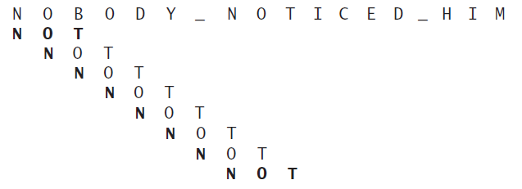

Slide 17
